Slide 1


Notes to Instructor
Material Needed
This Power Point
8 ½ x 11 sheets of paper (each person in class to have 1-2 sheets)
Hard copies of the SDTM IG V3.2 printed out and bound for each participant
Post-it Note Flags (rectangular and colored on one end) – each participant will need about 2-3 packs of these (~50 or so flags per person)
Each participant will need to bring their laptop to access workshop templates needed to complete workshop exercises
Handout of Power Point slides

Slide 2
Lilly Workshop Module 1 Overview of CDISC Process

Slide 3
Objectives
Encourage participation to enhance learning in this hands-on workshop
Provide study teams the opportunity to discover and understand end to end data flow
Present an overview of key step in any CDISC process, with an emphasis on Lilly’s process
Participants will be able to order key steps in the CDISC process and be able to relate each step to SDTM data sets

Slide 4
CDISC Overview

Slide 5
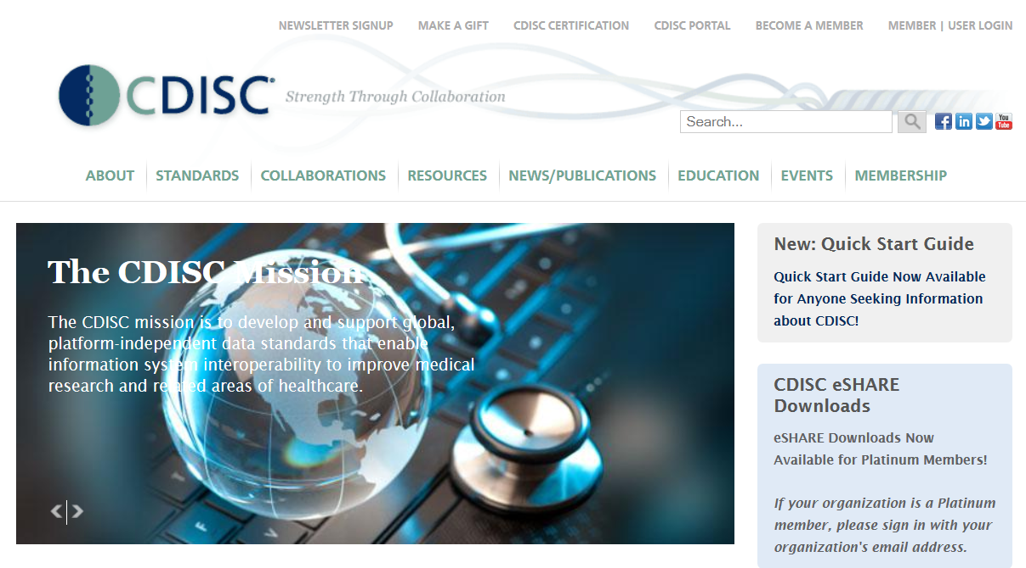
http://www.cdisc.org/

Slide 6

CDISC SDTM Current State
CDISC – Clinical Data Interchange Standards Consortium
SDTM – Study Data Tabulation Model
CDISC Web Site http://www.cdisc.org/
Current Documentation
SDTM v1.4
SDTM IG v3.2 (Implementation Guide)
SDTM IG-AP v1.0 (Associated Persons)
SDTMIG-MD v.1.0 (Medical Devices)
Therapeutic area domains coming fast and furious

Slide 7
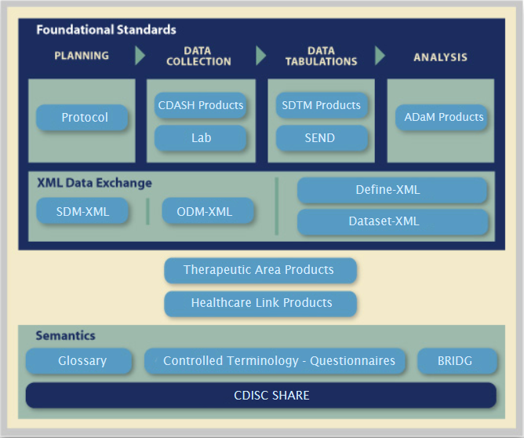

Overview of CDISC Process
https://www.youtube.com/watch?v=gCyVdvgVpY8&feature=youtu.be

Slide 8

CDISC Acronyms – Talk the Talk
CDISC – Clinical Data Interchange Standards Consortium
Data Collection:
CDASH – Clinical Data Acquisition Standards Harmonization
LAB – Laboratory Data Model
Data Tabulations:
SDTM – Study Data Tabulation Model
SEND – Standard for the Exchange of Nonclinical Data
Statistical Analysis:
ADaM – Analysis Data Model
XML Data Exchange:
SDM-XML – Study Design Model in XML
ODM – Operational Data Model
CRT-DDS – Case Report Tabulation Data Definition Specification (also called Define.xml)
Other:
BRIDG - Biomedical Research Integrated Domain Group Model
SHARE – Shared Health and Clinical Research Electronic Library
Go Back

Slide 9
SDTM in CDISC Process
Main Purposes of this Workshop:
Overview of CDISC process
Understand how SDTM data sets fit into the CDISC process
Understand the relationship between each CDISC component and SDTM data sets
Examples:
How does the “Protocol” relate to “SDTM” data sets?
How do “SDTM” data sets relate to an “FDA Submission”?

Slide 10
“Create Protocol” to “Submit to FDA”
We are going to generate the high level CDISC process steps as a group (with instructor guidance)
Does Lilly have any additional steps?
Consider:
What steps do you do in your daily job? What steps do others do?
Who helps with the data flow process?
Are there steps you have heard about but you may or may not know what they mean?
Lilly HQ Workflow Model (see if helpful)
Create Protocol
?
Submit to FDA
?
?
?
Go Back

Slide 11

Consider Order of Steps
What is the order of the steps from “Create Protocol” to “Submit to FDA”?
Must some steps happen before and after SDTM data sets are created?
Which steps might overlap the generation of the SDTM data sets?
Can there be variations in the order of the steps? If so, which order is most efficient?

Slide 12
Lilly Module 1 Exercise #1 – Create Steps from “Create Protocol” to “Submit to FDA”?

Slide 13
Brainstorm Steps “Create Protocol” to “Submit to FDA”
What are the key steps in the CDISC process at Lilly – Steps used by, completed by, and/or created by CDAs & Stat Analysts?
I’ve already given you two:
Create Protocol
Submit to FDA
Each person will write a high level step on a full size (8 ½ x 11) sheet of paper

Slide 14
Note to Instructor
As the group comes up with a high level step, assign that step to one of the participants
Participant is to write that step on a sheet of paper (preferably with a sharpie so it is easy to read across the room)
Provide suggestions by asking questions about their job, other’s jobs, etc.
Put up CDISC overview picture again to help generate ideas
Encourage participants to search the web if out of ideas

Slide 15

Assign Each Person to a Step
PROTOCOL
SDTM SPEC
FDA SUBMISSION
SDTM
ADaM

Slide 16

Some High Level Lilly Steps to Consider
SDTM Input into Study Build Design
Spec Writing & Review
SDTM Programming & Validation
SDTM Delivery
ADaM
TLFs
Define.xml
All steps impact SDTM!

Slide 17
Overview of Steps in the CDISC Process from Protocol to Submission

Slide 18

What Does Each Step Mean?
Create Protocol
Submit to FDA
SDTM Program & Validate
Input into Study Build Design
Generate Define.xml
Write SAP
Data Management
SDTM Study Specs
TFLs and Delivery
Annotate CRF (CRF → Raw)
Choose DEDs/CRF
Annotate CRF (CRF → SDTM)
ADaM Study Specs
Clinical Study Report (CSR)
ADaM Program & Validate
Jump to Exercise

Slide 19

Clinical Trial Protocol ICH – E6 Good Clinical Practices
General Information
Background Information
Trial Objectives and Purpose
Trial Design
Selection and Withdrawal of Subjects
Treatment of Subjects
Assessment of Efficacy
Assessment of Safety
Statistics
Direct Access to Source Data/Documents
Quality Control and Quality Assurance
Ethics
Data Handling and Recordkeeping
Financing and Insurance
Publication Policy
Supplements
http://www.fda.gov/downloads/drugs/guidancecomplianceregulatoryinformation/guidances/ucm073122.pdf
Go Back

Slide 20
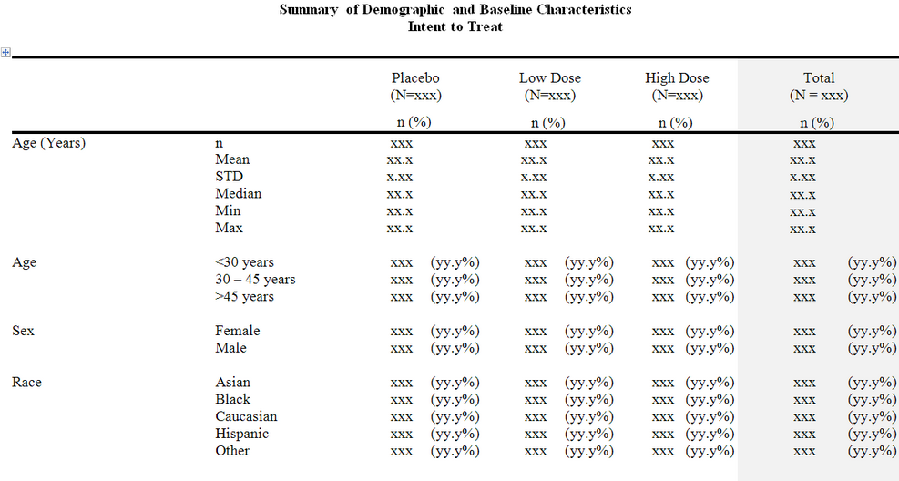
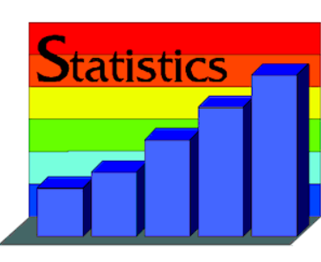
Write Statistical Analysis Plan (SAP)
From Protocol
Trial Design
Selection and Withdrawal of Subjects
Treatment of Subjects
Assessment of Efficacy
Assessment of Safety
Statistics
Includes mock table shells
Description of TFLs
Go Back

Slide 21
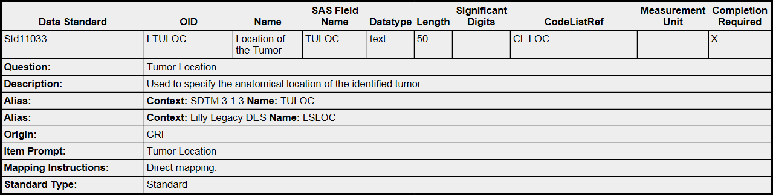
Input into Study Build Design
What variables are included?
Data Element Definitions (DEDs)
Mapping to SDTM
References to Controlled Terminology
Go Back

Slide 22
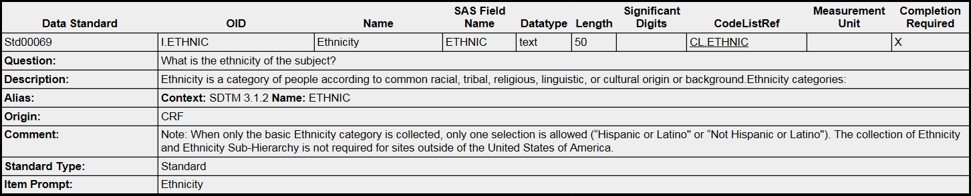
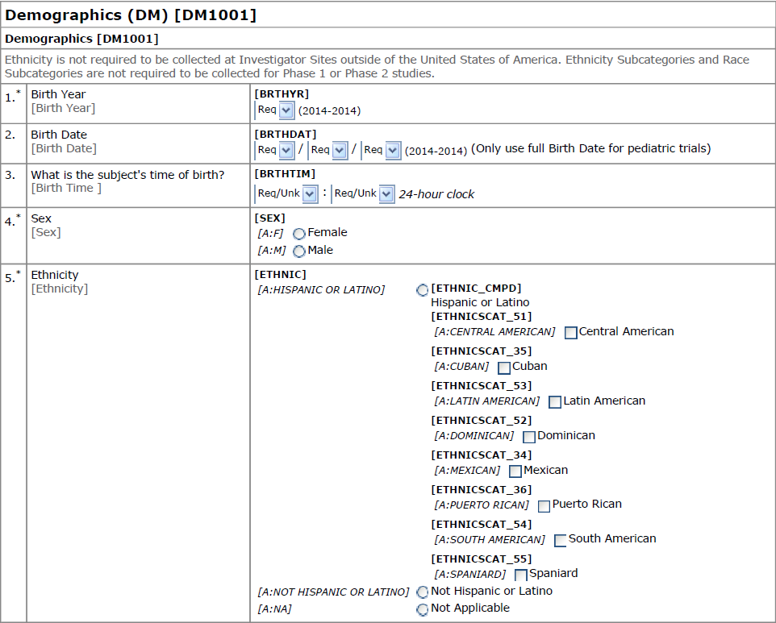
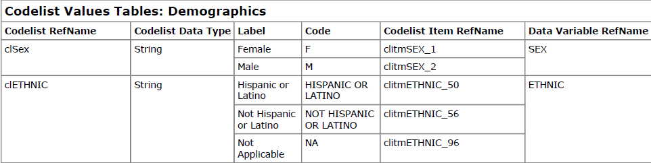
Choose DEDs/CRF
Go Back

Slide 23
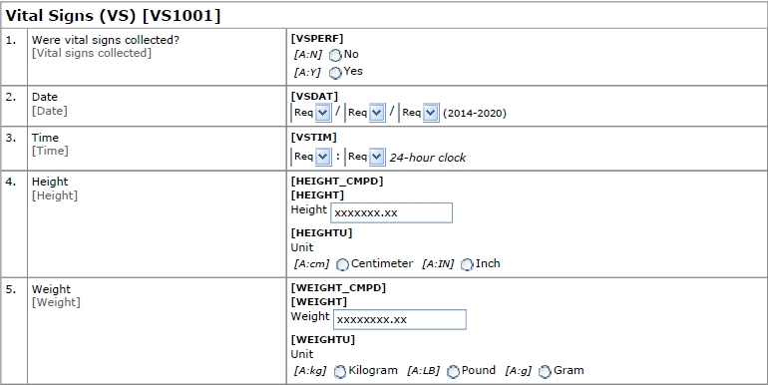
Annotated CRF (CRF → Raw Data)
CORE_CRF_VS1001_V4
Vital Signs CRF
Not SDTM variables
Go Back

Slide 24
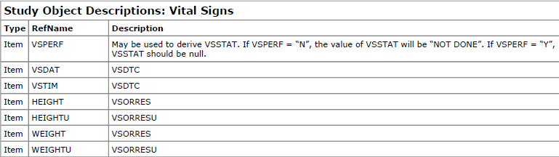
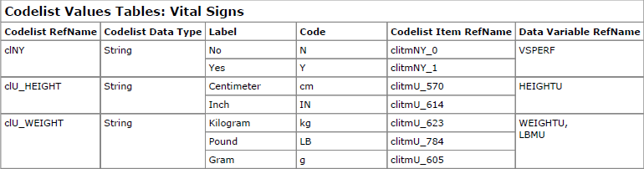
CRF Descriptions & Codelists
Go Back

Slide 25
Annotate CRF (CRF → SDTM) aCRF.pdf
VS = Vital Signs
[NOT SUBMITTED] vs VSSTAT to be covered in a different module
[NOT SUBMITTED]
VSSTAT
VSDTC
VSDTC
VSORRES where VSTESTCD = ‘HEIGHT’
VSTEST where VSTESTCD = ‘HEIGHT’
VSORRESU where VSTESTCD = ‘HEIGHT’
VSORRES where VSTESTCD = ‘WEIGHT’
VSTEST where VSTESTCD = ‘WEIGHT’
VSORRESU where VSTESTCD = ‘WEIGHT’
Go Back

Slide 26
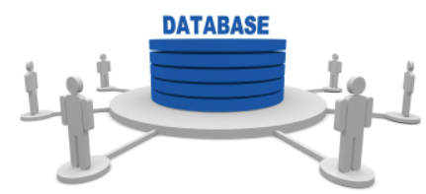
Data Management
Create electronic edit checks specifications
Create, review, finalize CRF instructions
Build InForm and perform testing
Site enrollment ready
System Go-Live
First Patient Visit (FPV)
Data Management
Site Enroll-ment
System Go-Live
FPV
Go Back

Slide 27
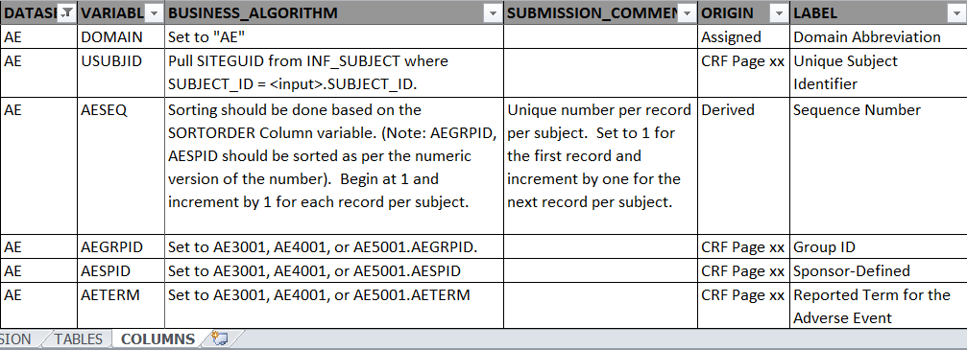
SDTM Spec Writing & Review
Example below: part of an SDTM Study Spec
Adverse Event (AE) SDTM domain
SDTM variables and associated metadata
Lilly specific BUSINESS_ALGORITHM for mapping
Go Back

Slide 28
SDTM Spec Writing & Review
Example below: part of an SDTM Study Spec
Adverse Event (AE) SDTM domain
SDTM variables and associated metadata
Lilly specific BUSINESS_ALGORITHM for mapping
Go Back

Slide 29
SDTM Mapping?
It can mean several things to different groups.
Annotations on a CRF with SDTM variables
SST Specification (.xls mapping raw data to SDTM using columns for the metadata attributes (Variable Name) and rows for the variable values (USUBJID)
Or doing the mapping in a programming language like SAS code with not several to very few supporting documents, SST (ex: map.sas)
Go Back

Slide 30
SDTM Programming & Validation
SDTM domains
Created from raw data
Uses the Study Specifications
Compliance to Standards
Trial Design Domains
Based on Protocol/Statistical Analysis Plan (SAP)
USUBJID | SESEQ | ETCD | EPOCH
1001 | 1 | SCRN | Screen
1001 | 2 | IV | First Treatment
1001 | 3 | FU | Follow-Up
Go Back

Slide 31
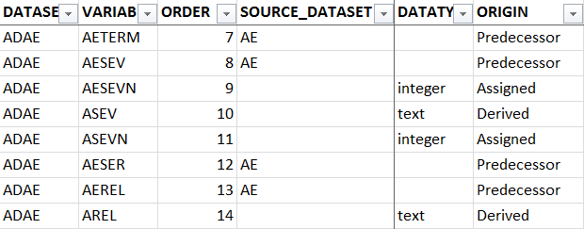
ADaM Spec Writing & Review
Key to Connect SDTM to ADaM
Use metadata to make connection
Described in business algorithm
Go Back

Slide 32
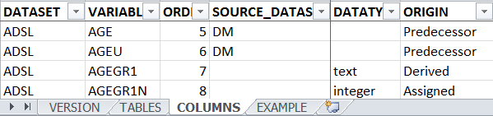
ADaM Programming & Validation
ADaM data sets
Created from SDTM data
Derived variables needed for analysis
Traceability SDTM → ADaM
ADaM data sets used for analysis to generate Tables, Figures, and Listings (TFLs)
ADaM data sets are “analysis ready”
Go Back

Slide 33
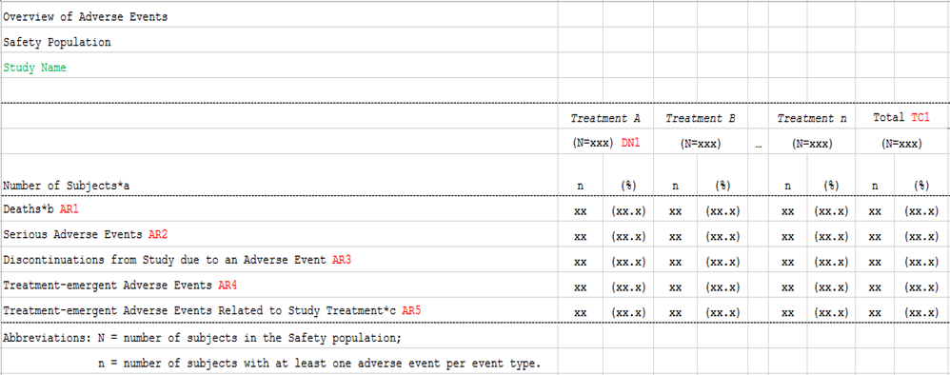
TFLs & Delivery
Tables/Figures generated using ADaM
Listings can be combination of ADaM/SDTM
Go Back

Slide 34
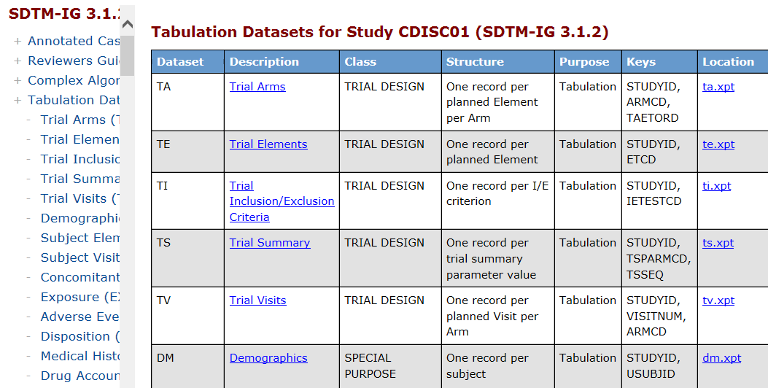
Generate Define.xml (contains aCRF.pdf for SDTM)
Go Back

Slide 35
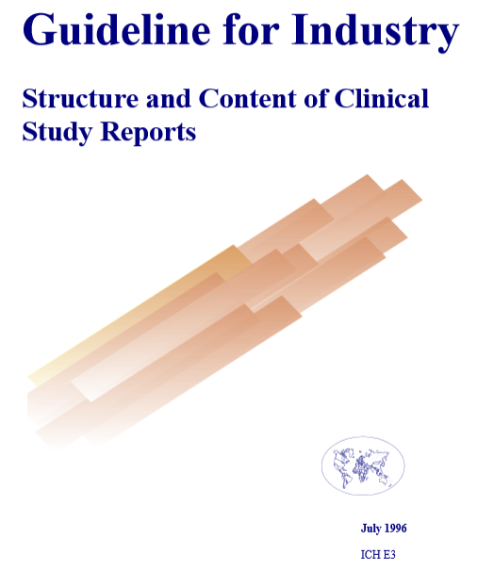
Write Clinical Study Report (CSR)
Investigational Plan
Study Patients
Efficacy Evaluation
Safety Evaluation
Discussion and Overall Conclusions
Tables & Figures
Reference List
Appendices
Synopsis
http://www.fda.gov/downloads/Drugs/GuidanceComplianceRegulatoryInformation/Guidances/UCM073113.pdf(See ICH Guidelines)
Go Back

Slide 36
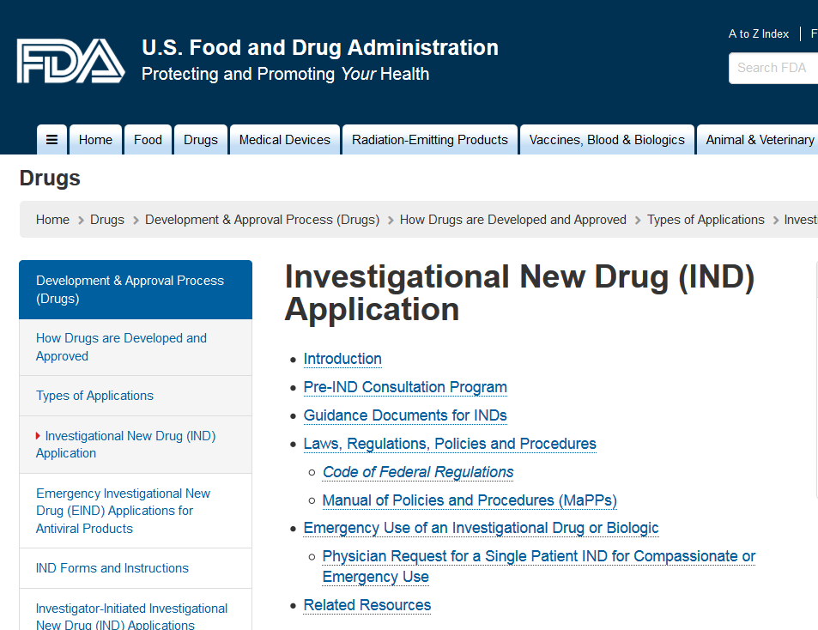
Submission to FDA
Go Back

Slide 37
Lilly Module 1 Exercise #2 – Order the Steps and Provide Relationship to SDTM

Slide 38
Exercise #2: Lilly Mod 1
Everyone stand up with your Lilly CDISC step
Order yourselves as the Lilly CDISC steps from Start to Finish with relation to SDTM
Explain how your Lilly CDISC step relates to SDTM
Explain how SDTM relates to your Lilly CDISC step
SDTM

Slide 39
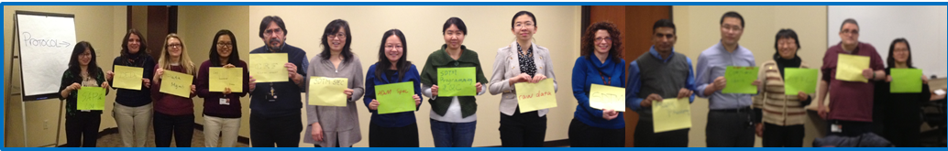
Are You In The Correct Order?
Go Back

Slide 40


Order Analogy – Board Games
Some have a clear START & FINISH
Some seem to go on endlessly

Slide 41
Possible Order (left to right and top to bottom)
Create Protocol
-1-
2) Write SAP
-2-
3) Input Study Build Design
-3-
4) Choose DEDs/CRF
-4-
Annotate CRF (CRF → Raw)
-5-
Annotate CRF (CRF → SDTM)
-6-
Data Management
-7-
SDTM Study Specs
-8-
SDTM Program & Validate
-9-
ADaM Study Specs
-10-
ADaM Program & Validate
-11-
TFLs and Delivery
-12-
Generate Define.xml
-13-
Clinical Study Report (CSR)
-14-
Submit to FDA
-15-

Slide 42
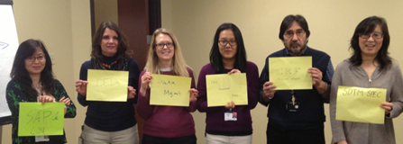
Summary
SDTM
CDISC consists of groups of people working together to create standard requirements
SDTM and the SDTM IG are Standards about Study Data
Lilly has implemented CDISC SDTM Standards
Ordering of the steps within Lilly’s CDISC process, from protocol to FDA submission (end to end), can vary and repeat throughout a study
All steps, and the work you do, affect the SDTM data sets and visa versa; the SDTM data sets affect all steps, and the work you do

Slide 43
End of Lilly Module 1 ☺

Slide 44
Additional Slides Lilly HQ Workflow Model

Slide 45
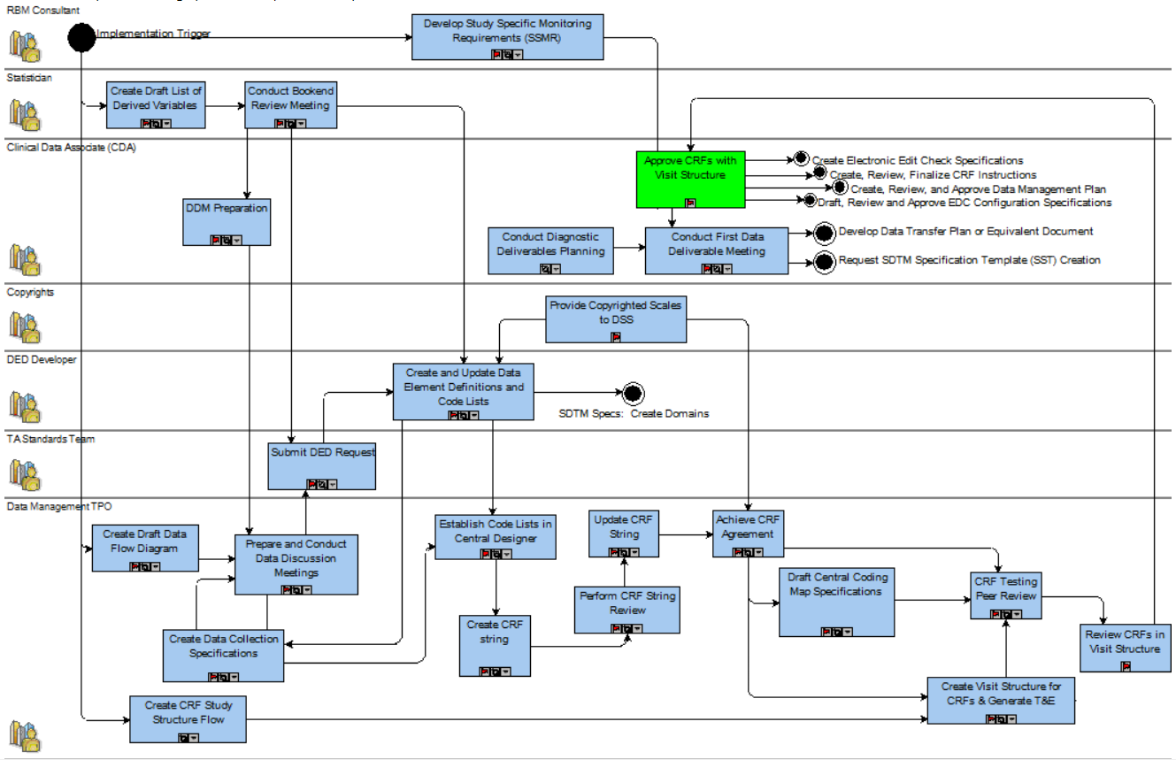
Lilly “HQ Workflow Model” IT to CRF Approval

Slide 46
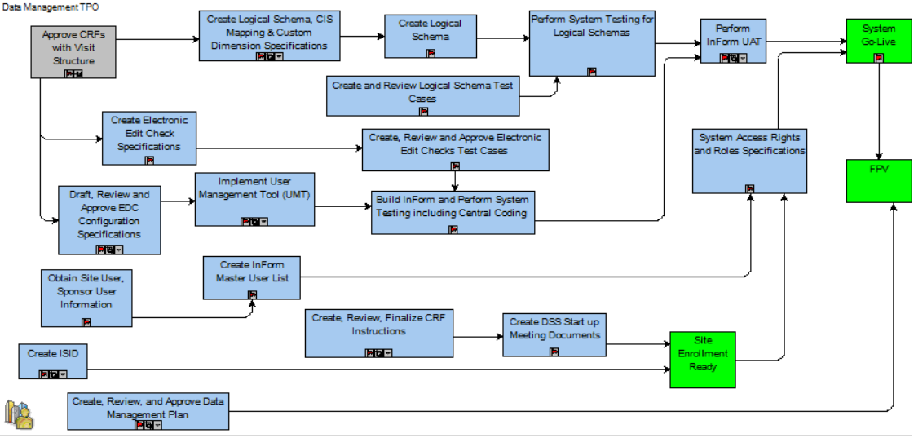
Lilly “HQ Workflow Model” CRF Approval to System Go Live

Slide 47
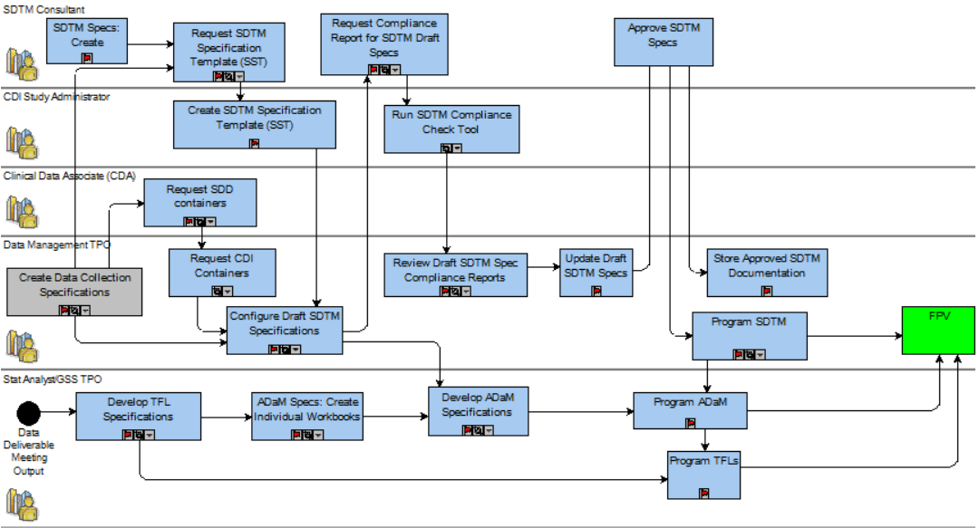
Lilly “HQ Workflow Model” Specifications to Programming

Slide 48
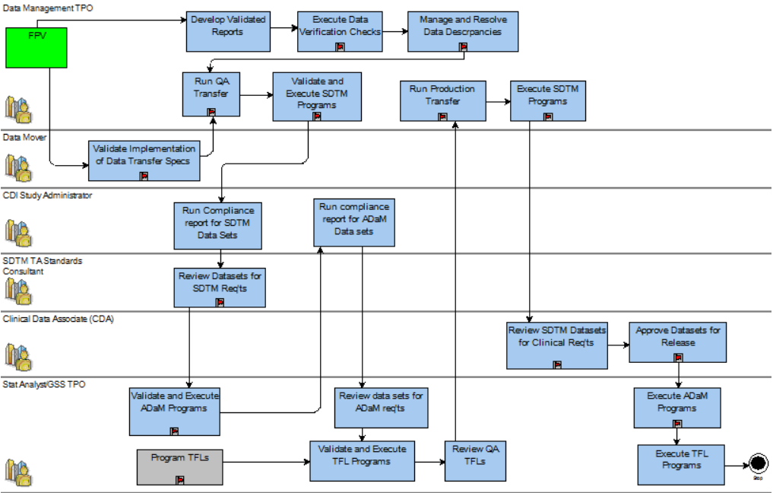
Lilly “HQ Workflow Model” FPV to First Data Delivery
Go Back

